Slide 1
Module 2 – Syntax Analysis
Bottom Up Parsing

Slide 2
LR parser
LR parsing is most efficient method of bottom up parsing which can be used to parse large class of context free grammar.
The technique is called LR(k) parsing:
The “L” is for left to right scanning of input symbol,
The “R” for constructing right most derivation in reverse,
The “k” for the number of input symbols of look ahead that are used in making parsing decision.
a | + | b | $
INPUT
X
Y
Z
$
LR parsing program
OUTPUT
Parsing Table
Action
Goto

Slide 3
Parsing Methods
Parsing
Top down parsing
Bottom up parsing (Shift reduce)
Back tracking
Operator precedence
Parsing without backtracking (predictive parsing)
LR parsing
SLR
LL(1)
CLR
Recursive
descent
LALR

Slide 4
Steps to construct Simple LR (SLR) parser
Construct Canonical set of LR(0) items
Construct SLR parsing table
Parse the input string

Slide 5
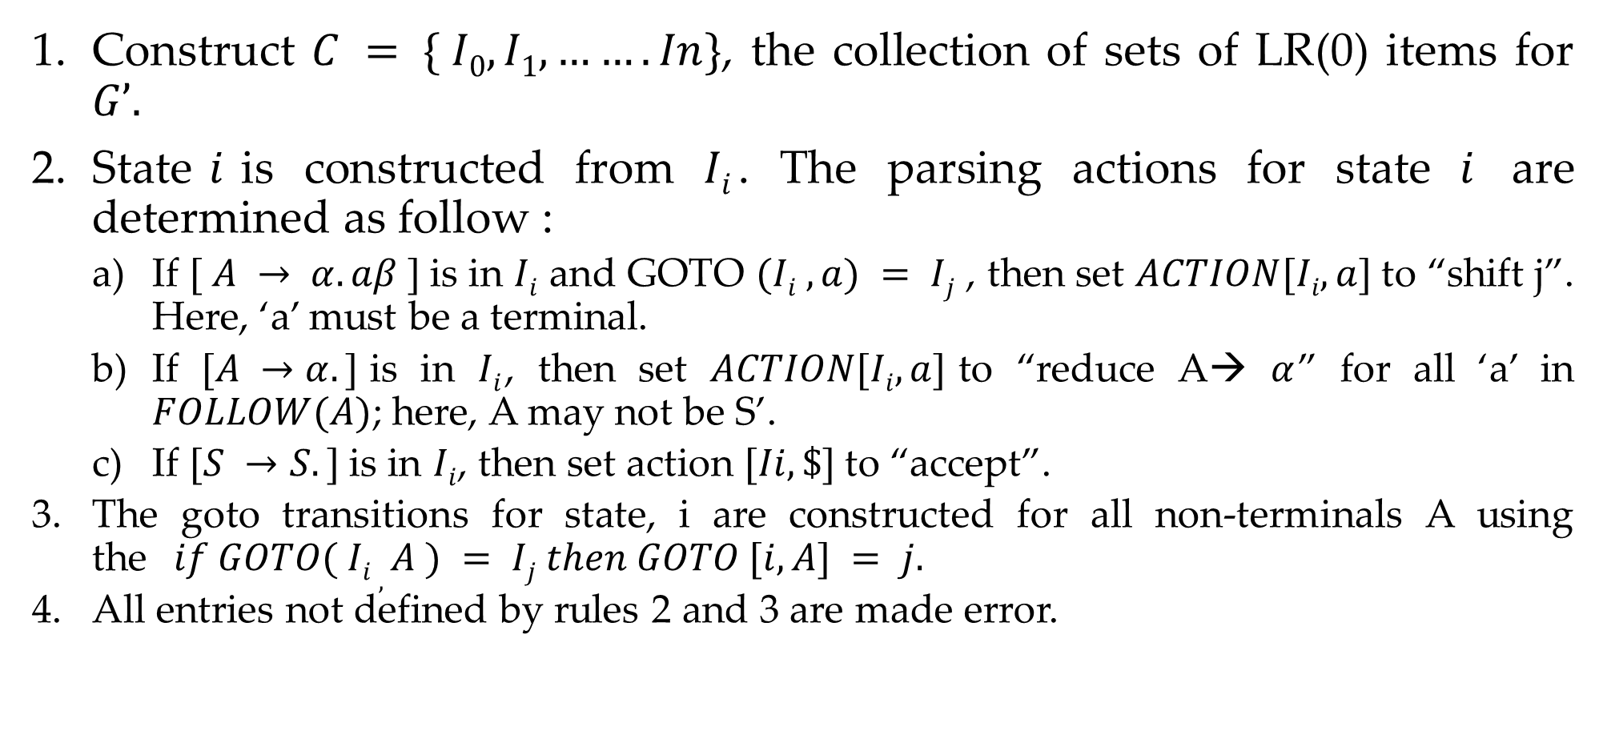
Rules to construct SLR parsing table
Construct $C = \{ I0, I1, ……. In\}$, the collection of sets of LR(0) items for $G’.$
State$i$is constructed from $Ii$. The parsing actions for state $i$ are determined as follow :
If $[ A → α.aβ ]$is in $Ii$ and GOTO $(Ii , a) = Ij$ , then set $ACTION[Ii, a]$to “shift j”. Here, ‘a’ must be a terminal.
If $[A →α.]$is in $Ii$, then set $ACTION[Ii, a]$to “reduce A→ $α$” for all ‘a’ in $FOLLOW(A)$; here, A may not be S’.
If $[S →S.]$is in $Ii$, then set action $[Ii, \$]$to “accept”.
The goto transitions for state, i are constructed for all non-terminals A using the$if GOTO( Ii , A ) = Ij then GOTO [i, A] = j.$
All entries not defined by rules 2 and 3 are made error.

Slide 6
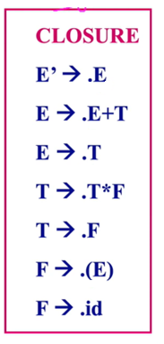
Computation of closure & goto function
Closure(I):
If ‘I’ is a set of items for a grammar, G then closure of I (closure (I)) is set of items constructed from I by applying following 3 rules:
Construct augmented grammar.
Initially, every item in I is added to closure(I).
If A → α • B β is in closure (I) and B ⟶ ४ is a production, then add the item B ⟶ •४ to I, if it is not already in existence, we apply this rule until no more new items can be added to closure(I).
Example:
E→ E+T | T
T→ T*F | F
F→ (E)| id

Slide 7
Computation of closure & goto function
Goto(I,X)
The function goto can be defined as,
If there is a production A → α • B β then,
goto (A → α • B β, B) = A → α B • β.
Simply shifting of “•” one position ahead over grammar symbol.
Example:
E→ E+T | T
T→ T*F | F
F→ id | (E)

Slide 8
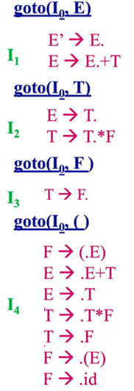
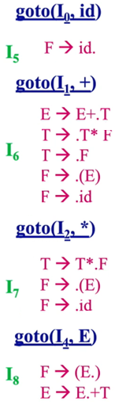
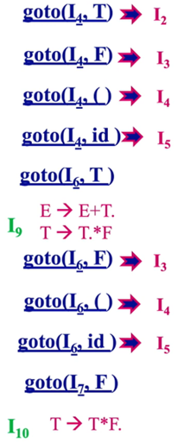
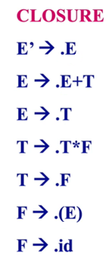

Slide 9
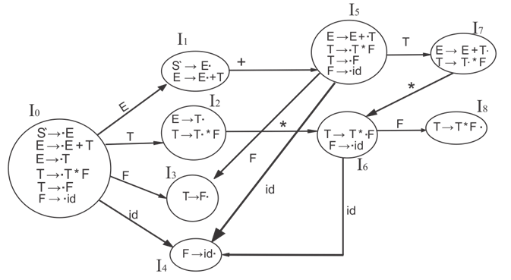
Solution1 – canonical form

Slide 10
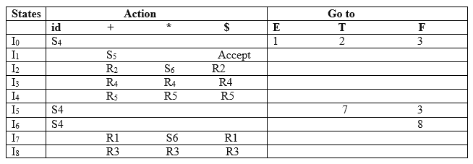
Solution1 – parsing table

Slide 11







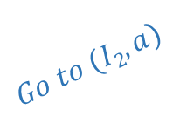


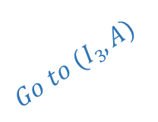








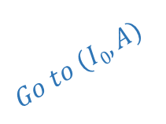
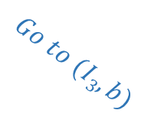
Example 2: SLR(1)- simple LR
S-->AA
A-->aA | b
S→ AA .
$I$₅
S’→ S.
$$I1$$
$$Go to (I2,A)$$
A→ a . A
$$Go to (I0,S)$$
$$I2$$
A→. aA
$I$₃
$$I0$$
S→ A . A
A→. b
S’→S
S’→.S
$$Go to (I2,a)$$
$$Go to (I0,A)$$
A→. aA
S→AA
S→. AA
A→. b
A→ b.
$I$₄
A→aA
A→. aA
$$Go to (I2,b)$$
A→b
A→. b
$$Go to (I0,a)$$
LR(0) item set
$I$₃
A→ aA .
$I$₆
Augmented
Grammar
$$Go to (I3,A)$$
A→ a . A
$$Go to (I0,b)$$
A→. aA
$$Go to (I3,a)$$
A→ a . A
$I$₄
A→. b
A→. aA
$I$₃
A→ b.
$$Go to (I3,b)$$
A→. b
A→ b.
$I$₄

Slide 12










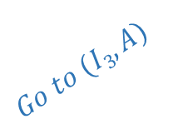




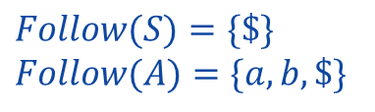




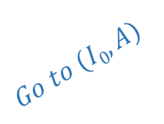

Example 2: SLR(1)- simple LR
$$Follow(S)=\{\$\}$$
$$Follow(A)=\{a, b, \$\}$$
S→ AA .
$I$₅
S’→ S.
$$I1$$
 | Action |  |  | Go to
Item set | a | b | $ | S | A
0 | S3 | S4 |  | 1 | 2
1 |  |  | Accept
2 | S3 | S4 |  |  | 5
3 | S3 | S4 |  |  | 6
4 | R3 | R3 | R3
5 |  |  | R1
6 | R2 | R2 | R2
$$Go to (I2,A)$$
A→ a . A
$$Go to (I0,S)$$
$$I2$$
A→. aA
$I$₃
$$I0$$
S→ A . A
A→. b
S’→. S
$$Go to (I2,a)$$
$$Go to (I0,A)$$
A→. aA
S→. AA
A→. b
A→ b.
$I$₄
A→. aA
$$Go to (I2,b)$$
A→. b
$$Go to (I0,a)$$
$I$₃
A→ aA .
$I$₆
$$Go to (I3,A)$$
A→ a . A
$$Go to (I0,b)$$
A→. aA
$$Go to (I3,a)$$
A→ a . A
$I$₄
A→. b
A→. aA
$I$₃
A→ b.
$$Go to (I3,b)$$
A→. b
S-->S’ -------(0)
S-->AA -------(1)
A-->aA --------(2)
A-->b ---------(3)
A→ b.
$I$₄

Slide 13
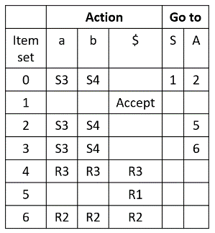
Parse the string aabb using SLR parser
Parsing Table
Stack | Input | Action
0 | aabb$ | Shift I0->a, S3
0a3 | abb$ | Shift I3 ->a, S3
0a3a3 | bb$ | I3->b, S4
0a3a3b4 | b$ | I4->b, R3 | Pop 4, goto(I3,A)=6
0a3a3A6 | b$ | I6->b, R2
0a3A6 | b$ | I6->b, R2
0A2 | b$ | I2->b, s4
0A2b4 | $ | I4->$, r3 | Pop 4, goto(I2,A)=5
0A2A5 | $ | I5->$,r1 | Pop 5, goto(I0,S)=1
0S1 | $ | Accept
S-->S’ -------(0)
S-->AA -------(1)
A-->aA --------(2)
A-->b ---------(3)

Slide 14
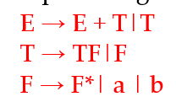
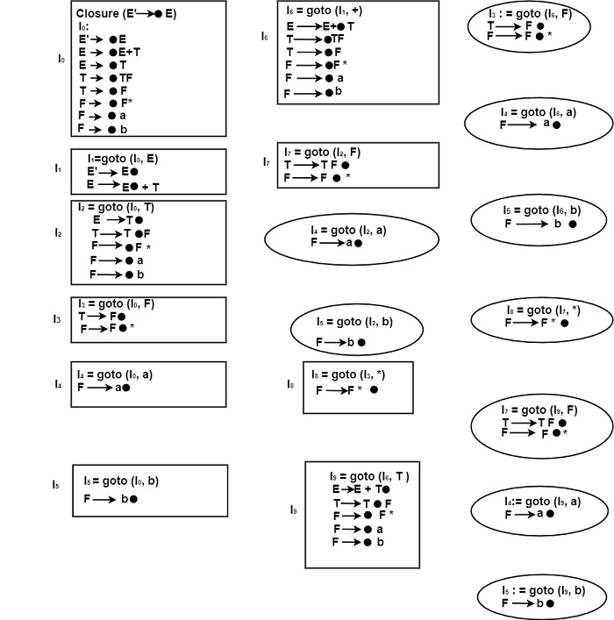
Example 3

Slide 15
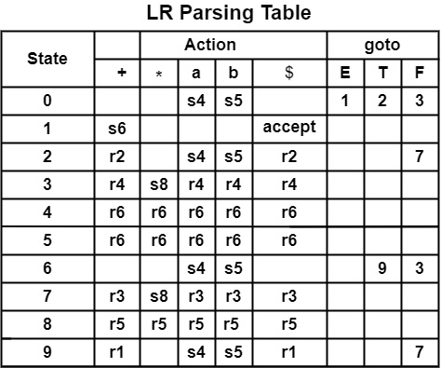
Solution3 – parsing table

Slide 16
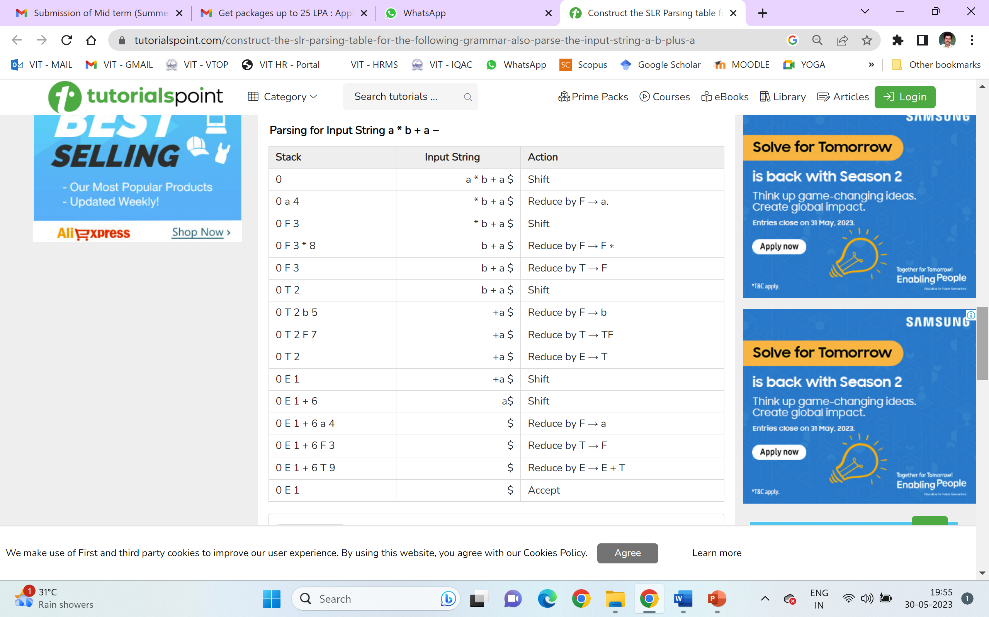
Solution3 – parsing the string
E → E+T (r1)
E → T (r2)
T → TF (r3)
T → F (r4)
F → F* (r5)
F→ a (r6)
F → b (r7)

Slide 17
With Conflicts

Slide 18
Example:4
Construct SLR parsing table for the following grammar:
S-->Aa | bAc| Bc | bBa
A-->d
B-->d
Solution:
Step 1: Grammar Augmentation
S’-->S … rule 0
S-->Aa … rule 1
S-->bAc … rule 2
S-->Bc …. rule 3
S-->bBa ….rule 4
A-->d …. rule 5
B-->d … rule 6
Step 2: Closure operation
S’-->.S
S-->.Aa
S-->.bAc
S-->.Bc
S-->.bBa
A-->.d
B-->.d

Slide 19
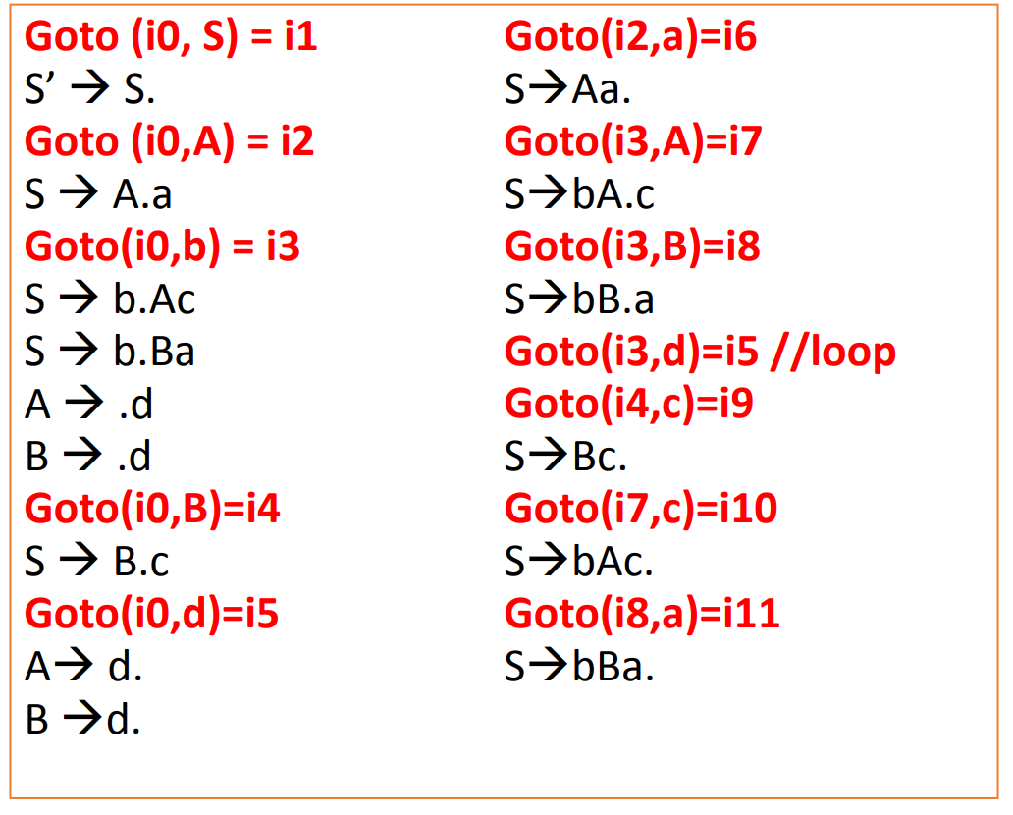
Cont…

Slide 20
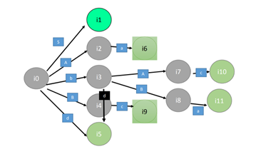
Cont… Canonical Form

Slide 21
S’-->S … R0
S-->Aa … R1
S-->bAc … R2
S-->Bc …. R3
S-->bBa ….R4
A-->d …. R5
B-->d … R6

Slide 22
Example:5
Construct SLR parsing table for the following grammar
S → L = R | R
L → * R | id
R → L

Slide 23
Solution2 – canonical form

Slide 24
Solution2 – cont…

Slide 25
Solution2 – parsing table

